Slide 1
User Research Study 2 Benefit Lifecycle
Prepared by the Digital Service at Veterans Affairs (DSVA)
Prepared for and presented to the VA Web Brand Consolidation Working Group
April 2018

Slide 2
Outline
We wanted to know if Veterans would organize information using the benefit lifecycle.
1. Study Objectives
2. Research Method
3. Findings
4. Recommendations

Slide 3
1. Study Objectives

Slide 4
Our goal was to find if our proposed benefit lifecycle works for Veterans.
Study objectives
Can users consistently group content by the proposed spoke model?
Explore & Apply
Track & Manage
More From VA
What type of content ends up in "More From VA”?

Slide 5
2. Research Method

Slide 6
Veterans showed us which of the buckets they would use to arrange the top links
Research Method
Created a closed card sort in Optimal Workshop
20 cards, 3 categories
Distributed to 4k Veterans via MyHealtheVet mailing list
Received 240 responses (Apr 5 – Apr 20)
95% Veterans, several spouses and other family

Slide 7
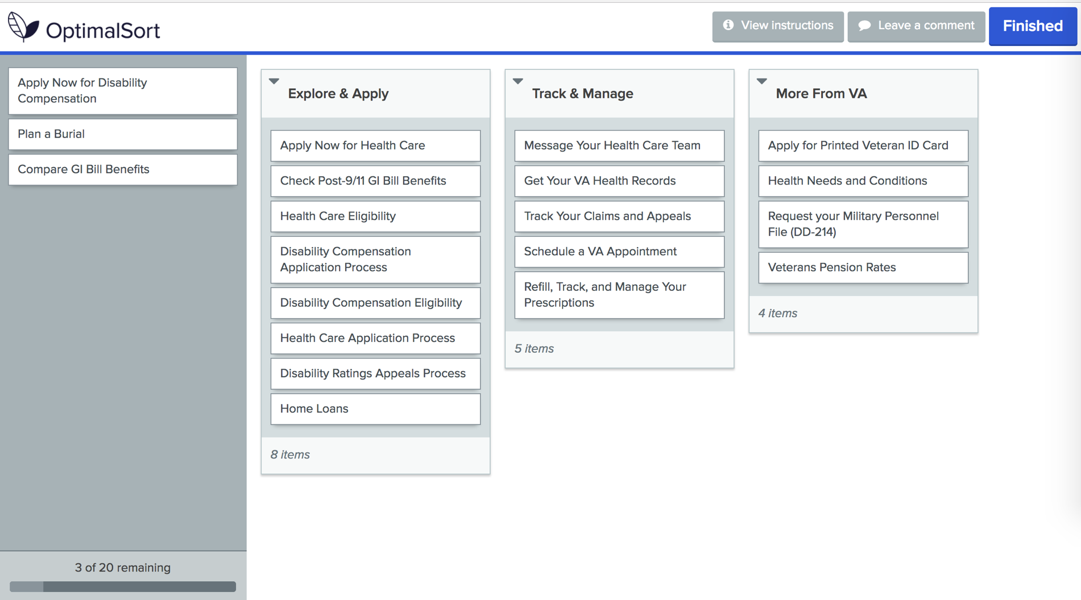

Slide 8
3. Findings

Slide 9
How we would have grouped the items…
Explore & Apply
Track and Manage
More From VA
Health Care Application Process
Health Care Eligibility
Apply Now for Health Care
Disability Compensation Eligibility
Disability Compensation Application Process
Apply Now for Disability Compensation
Apply for Printed Veteran ID Card
Refill, Track, and Manage Your Prescriptions
Message Your Health Care Team
Schedule a VA Appointment
Get Your VA Health Records
Track Your Claims and Appeals
Check Post-9/11 GI Bill Benefits
Request your Military Personnel File (DD-214)
Health Needs and Conditions
Disability Ratings Appeals Process
Compare GI Bill Benefits
Veterans Pension Rates
Plan a Burial
Home Loans

Slide 10
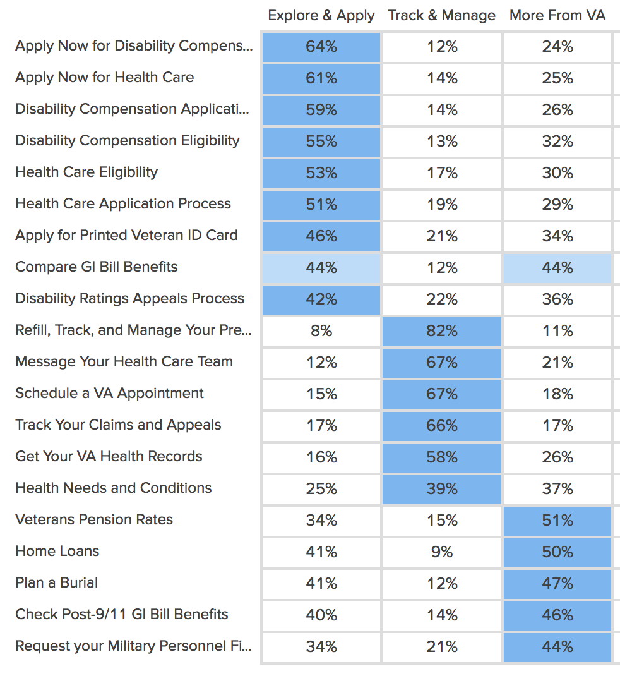
How Veterans grouped the items…

Slide 11
Some content worked better than others
Explore & Apply
Track and Manage
More From VA
Health Care Application Process
Health Care Eligibility
Apply Now for Health Care
Disability Compensation Eligibility
Disability Compensation Application Process
Apply Now for Disability Compensation
Apply for Printed Veteran ID Card
Refill, Track, and Manage Your Prescriptions
Message Your Health Care Team
Schedule a VA Appointment
Get Your VA Health Records
Track Your Claims and Appeals
Check Post-9/11 GI Bill Benefits
Request your Military Personnel File (DD-214)
Health Needs and Conditions
Disability Ratings Appeals Process
Compare GI Bill Benefits
Veterans Pension Rates
Plan a Burial
Home Loans

Slide 12
Organizing benefits around the lifecycle makes sense to Veterans
Findings
Explore & Apply works well for the items we thought fit in that category like “Health Care Eligibility”
Many Track & Manage cards were consistently sorted by Veterans, but other items including “Request DD-214” don’t fit
Several items including “Compare GI Bill Benefits” aren’t easily placed in only one category
More From VA cards had the most inconsistent placement but did not distract Veterans from the benefit lifecycle

Slide 13
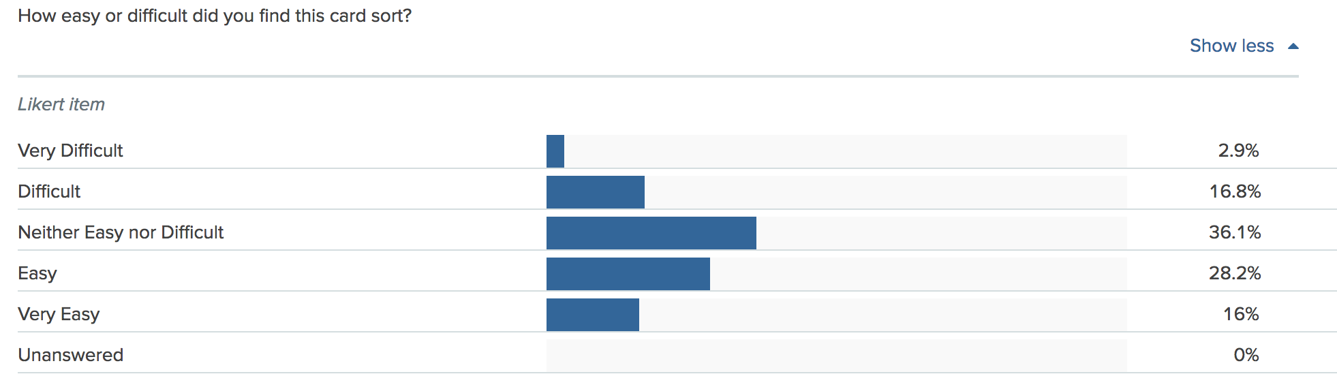
Veterans tended to find the activity easy to complete

Slide 14
4. Recommendations

Slide 15
What Now?
Recommendations
We learned that the benefit lifecycle can work as part of the content strategy but applying it to the content hubs will take finesse.

Slide 16
Applying the benefit lifecycle will require careful planning
Recommendations
Veterans consistently understand the difference between the Explore & Apply vs Track & Manage phases of the benefit lifecycle
Content should be tested before sorting it under a spoke, especially Track & Manage items
Veterans will not be distracted by a More From VA spoke but it cannot be used as a way to consistently locate content
Labels for content spokes can use the terms “Explore, Apply, Track, and Manage”

Slide 17
Thank you!
Contact Jeff Barnes with questions:
jeffrey.barnes4@va.gov

Slide 18
Did we answer our research questions?
Study objectives
Can users consistently group content by the proposed spoke model?
Explore & Apply – Yes they can
Track & Manage – Yes, but not everything fits
More From VA – Yes, but don’t expect them to look there first
What type of content ends up in "More From VA”? Content that does not fit in the other two categories or does not have a clear home.

